Slide 1



Introduction to the Simon Game
Welcome to the Simon Game project! Get ready to experience a classic game of memory and reaction time.
by Pranay Aggarwal
Krishnam Agarwal
Vishesh Maurya
Anurag Sharma

Slide 2

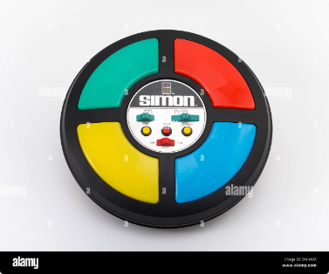
Overview of the Simon Game Project
Classic Game
Java Implementation
User Interaction
The Simon game has been a popular electronic game for decades, testing memory and reaction time.
This project implements the Simon Game in Java, taking advantage of its robust programming capabilities.
Players interact with the game through visual cues and input mechanisms, making it engaging and accessible.

Slide 3

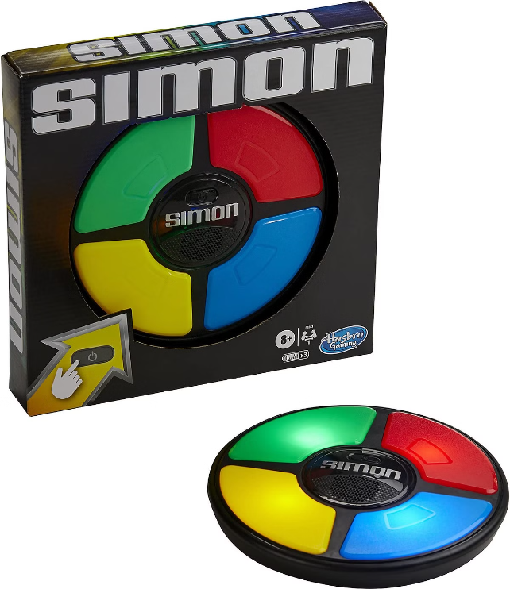
Key Features of the Simon Game
1
Color Sequences
2
Increasing Difficulty
The game presents a sequence of colors, which players must remember and repeat.
The game progressively increases the length of the color sequences, challenging players further.
3
User Input
4
Score Tracking
Players input their sequence by clicking on the corresponding colored buttons.
The game keeps track of the player's score, showcasing their progress and accuracy.

Slide 4

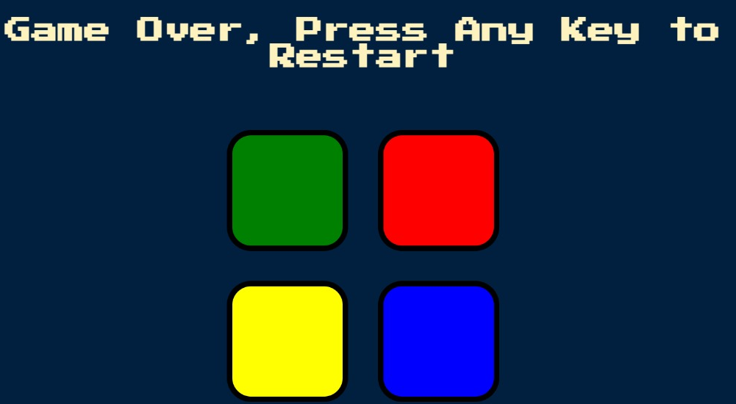
Game Mechanics and Gameplay
1
Start Game
The game begins with a short sequence of colors, displayed visually to the player.
2
User Input
Players must repeat the sequence by clicking the corresponding color buttons in the correct order.
3
Level Progression
If successful, the game progresses to the next level with a longer sequence of colors.
4
Game Over
If the player makes a mistake, the game ends, and the final score is displayed.

Slide 5
Technical Implementation Details
User Interface
Game Logic
Data Structures
The user interface is built using Java's Swing library, providing a visually appealing and interactive experience.
The core game logic, including color sequence generation and user input handling, is implemented in Java.
Arrays and lists are used to store and manipulate the color sequences, ensuring efficient processing.

Slide 6

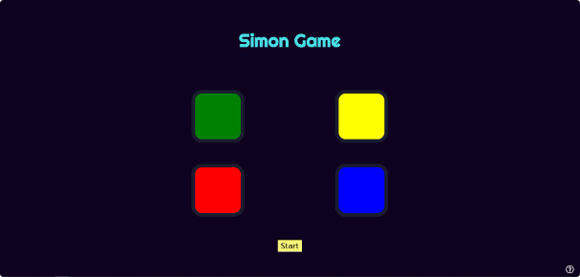




User Interface and Design Considerations
Color Scheme
Visual Clarity
Audio Feedback
User-friendliness
Vibrant and contrasting colors are used for the buttons, ensuring easy visibility and differentiation.
The user interface is designed with clear visual cues and minimal clutter, enhancing player focus and gameplay.
Audio cues are incorporated to provide feedback on correct and incorrect inputs, making the game more engaging.
The interface is intuitive and easy to navigate, allowing players of all skill levels to enjoy the game.

Slide 7





Challenges and Lessons Learned
Input Handling
Ensuring accurate and responsive input handling was a key challenge, requiring careful event management.
Game Difficulty
Balancing the game's difficulty levels to create a challenging yet engaging experience was crucial.
Code Optimization
Optimizing the code to ensure smooth gameplay and minimize lag was an important consideration.

Slide 8

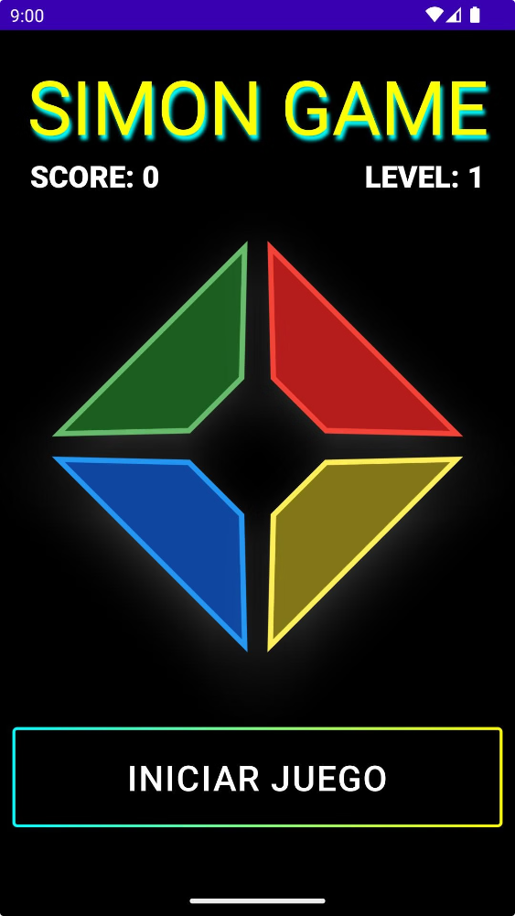
Conclusion and Future Enhancements
Conclusion
This Java-based Simon Game project provides a fun and engaging experience, testing memory and reaction time.
Future Enhancements
Adding new game modes, difficulty levels, and user customization options can further enhance the game.

